Slide 1

Comparing the performance of state-of-the-art software switches in the context of NFV
Tianzhu Zhang

Slide 2
About me
2020, 8 – now Research Engineer @ Nokia Bell Labs
2017,10 – 2019,11 PostDoc @ Telecom ParisTech
2017, 6 – 2017, 9 Intern @ Nokia Bell Labs

Slide 3

About the project
Joint work of TPT, NBLF, and PoliTO
Collaborators:
Leonardo Linguaglossa (Telecom Paris, Paris)
Massimo Gallo (Nokia Bell Labs, Paris-Saclay)
James Roberts (Telecom Paris, Paris)
Luigi Iannone (Telecom Paris, Paris)
Paolo Giaccone (Politecnico di Torino, Turin)
Published results:
Demo at IEEE Netsoft’19
Paper at ACM CoNEXT’19
On-going extension

Slide 4
Outline
Background
Network Function Virtualization (NFV)
Software switches
Motivation
Methodology
Experimental results
Conclusion
Test scenarios
Testbed settings

Slide 5

Background

Slide 6
Ossification of traditional networks
Specialized hardware appliances, aka. Middleboxes
Very expensive
Difficult to manage
Inflexible to customize
Tightly coupled with hardware production cycle
Tedious service deployment and maintenance
Non-trivial to scale in/out
Notes:
Tied to specialized hardware appliances

Slide 7
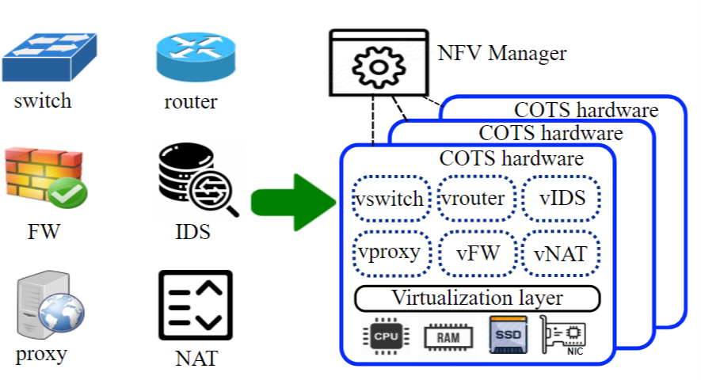
Network Function Virtualization (NFV)
Shift towards agile and open service provisioning
Virtual network functions (VNFs) on Commodity Off-The-Shelf (COTS) hardware
Notes:
NFV is proposed to tackle these issues.
What’s NFV?
Replacing specialized middleboxes with software-based virtual network functions (VNFs) deployed on commodity off-the-shelf hardware.
Separating the evolution timelines of software-based virtual network functions and specialized hardware.
Achieve cost-effectiveness by consolidating multiple network functions on high-volume, yet less expensive servers.
Service provisioning can be optimally automated and flexibly managed through software control mechanisms.
Network function development is cut down to writing software programs using standard API, NFV remarkably promotes network innovation and accelerates the time-to-market process.

Slide 8

Software switches
Virtual switch implemented in software
High flexibility
Low performance
Previously only used for fast-prototyping and function testing
Benefit from high-speed packet I/O techniques
DPDK, netmap, PF_ring, eBPF, VMA, etc.
Widely adopted by existing NFV frameworks
Traffic steering between VNFs and network interface cards (NICs)
Notes:
Virtual switches implemented in software and function the same as hardware switches.
They are more flexible thanks to the software nature, but usually fall short of performance

Slide 9
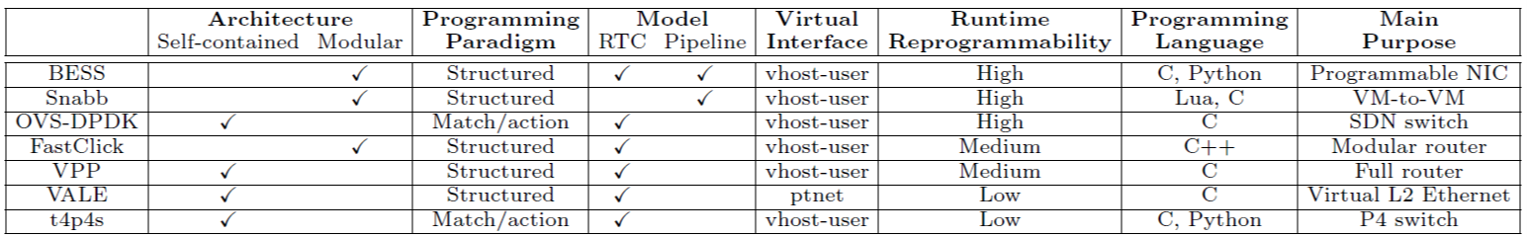
Unclear performance
Disparate design choices and purposes
Performance depend on traffic patterns
Too many hardware and software parameters to tune
Notes:
Lack of understanding of their respective performance, due to several reasons:
As the taxonomy shown in the table, software switches are born different.
Architecture, processing paradigm, execution model, virtual interfaces, runtime reconfigurability, programming languages. Although adopted by existing NFV frameworks, they do have their primary design purposes
Performance depends on input traffic and low-level parameters

Slide 10
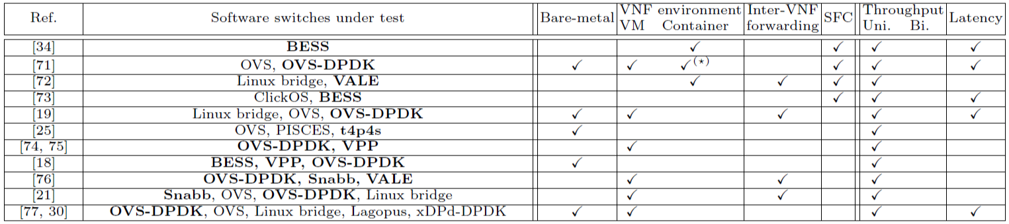
Existing works
Notes:
Taxonomy of existing performance benchmarking works
Test different switches, both high-speed domain and low-speed domain
Test environment:
Bare-metal forwarding efficiency
Interacting with different virtual environment
Test scenarios:
Inter-VNF communication
Service function chains
Performance metrics
Throughput: bidirectional traffic is more important but usually ignored
Latency
Problem of prior works: only focused on a facet of the problem in their particular settings, there is a lack of a unified understanding.

Slide 11
Our contribution
Experimental methodology to thoroughly evaluate the performance of software switches for NFV
Compare the performance of 7 state-of-the-art high-speed software switches, quantitative-> qualitative
Define the best use case for each tested software switch
Notes:
Based on quantitative results, perform qualitative analysis
The goal is not to find performance in absolute terms, performance vary with testbed, versions of other software tools, kernel/OS upgrades

Slide 12
Methodology

Slide 13
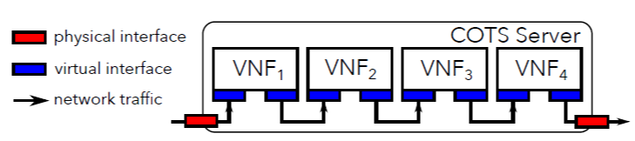
Typical NFV scenario
Service function chain (SFC)
Notes:
In NFV settings, services are mostly provisioned in the form of SFCs.
A typical scenario in which part of a service chain is deployed on a single server. 2 physical NICs, 4 VNFs, each with 2 virtual interfaces.
To detailedly understand performance and identify bottlenecks.
Our observation: dissect the service chain into several critical hops: physical interface to virtual interface, between interfaces, virtual interface to physical interface

Slide 14
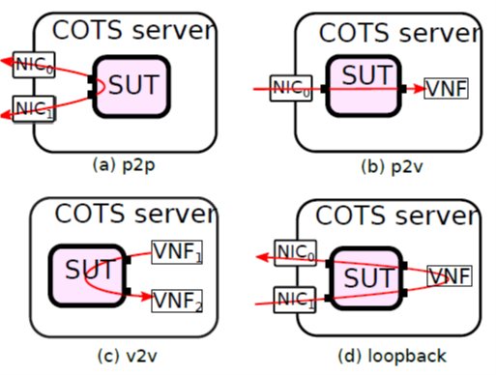
Test scenarios
Physical-to-physical (p2p)
Physical-to-virtual (p2v)
Virtual-to-virtual (v2v)
Loopback
Notes:
p2p: baseline reference to evaluate the overhead imposed by network functions running in virtual environment
p2v: can be mapped to the first hop of a SFC inside the server. We also considered the reverse direction that can be mapped to the last hop of SFC inside a server
v2v: used to assess traffic exchanging performance between consecutive VNFs in a service chain
Loopback: combines the previous scenarios. We consider service chains with 1-5 VNFs

Slide 15
Software switches under test
OVS-DPDK
FastClick
Berkley Extensible Software Switch (BESS)
Vector Packet Processing (VPP)
t4p4s
Snabbswitch
Netmap/VALE
Notes:
Open source, widely used in NFV community, run at high-speed (10 Gbps) even with relatively small packets

Slide 16
Tools
Traffic generators and monitors @ 10Gbps
MoonGen
pktgen-DPDK
pkt-gen
FloWatcher-DPDK
Hypervisors
QEMU/KVM + CentOS 7
Docker
Virtual network functions
Traffic monitors
testpmd/VALE
Notes:
The main challenge is configuring the large set of tools to implement the defined test scenarios

Slide 17
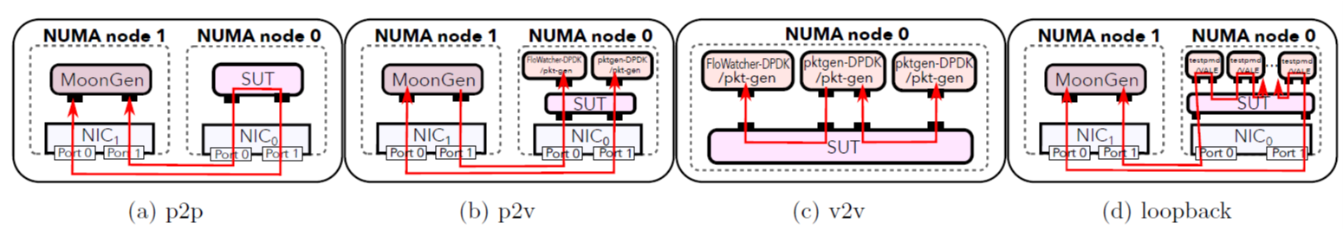
Testbed settings
Notes:
Detailed configuration of the previous logical test scenarios, Single server on two NUMA nodes to emulate two servers. 4 physical ports @ 10 Gbps, each pair is directly connected using a real cable.
P2p: MoonGen,
P2v: uni/bi
V2v: Single NUMA node to emulate single server and measure the VNF traffic exchange inside, uni/bi
Loopback: real network functions perform l2 forwarding. Simple VNF with minimal computation, not to bias the performance of software switches

Slide 18
Experimental parameters
Traffic patterns
Synthetic packets with 64B, 256B, and 1024B
CPU assignment
Single core for software switches
Four cores for each VNF
Virtual environment
VM and container
Performance metrics
Throughput: in Gbps, both unidirectional and bidirectional
Latency: Round-Trip time under 0.1/0.5/0.99 of the maximal forwarding rate
Notes:
Traffic patterns: synthesized identical packets. We only change the size. We will include more complex traffic patterns in future work
Simple traffic and minimal VNF processing, don’t introduce other bottlenecks, baseline performance of the software switches under test
CPU pinned to software switches and VNFs, no interference from the kernel.
Virtual environment, both VM and container, unikernel and other virtualization techniques in the future
Performance metric
Throughput: uni/bi
Latency: inject specially timestamped packets and measure their RTT under 10%, 50%, 99% of the maximal forwarding rate of each individual software switch, reflect their processing latency under high, medium, and low input workload.

Slide 19
Experimental results

Slide 20
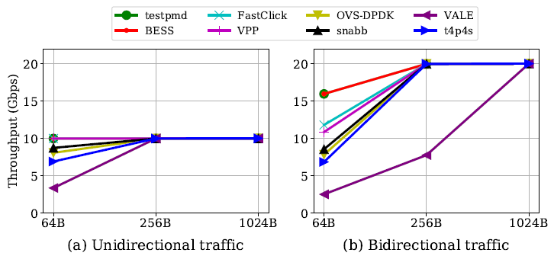
Throughput test for p2p scenario
Notes:
testpmd: DPDK app configured to simply forward all packets as they are, as baseline
In general, with 256B packets, all switches can reach the 10/20 Gbps
Uni test: BESS, fastclick, VPP @ 10 Gbps. Snabb failed due to the overhead imposed by its intermediate buffers. OVS-DPDK and t4p4s failed due to their match/action pipelines. VALE switch -> packet copying operation between physical ports
Bi test: same trend, most of them reached 20 Gbps with >256B packets, BESS performs the same as the baseline testpmd, FastClick fails to do that since header extraction and update, VPP->field verifications.

Slide 21
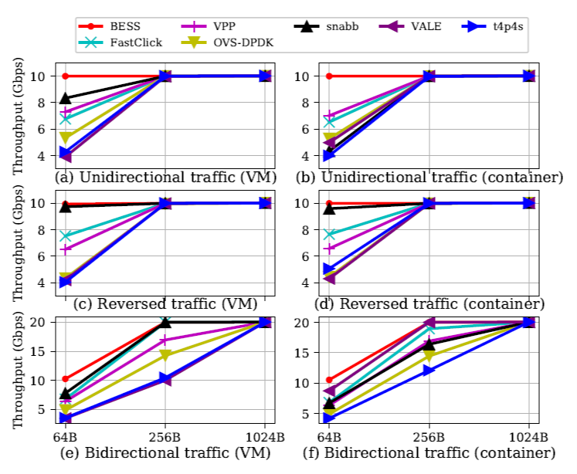
Throughput test for p2v scenario
Notes:
VNFs running in both VMs and containers,
Unidirectional/bidirectional
Performance trend of software switches are the same, most of them perform a little worse than before. Compared to p2p, we only substitute a physical port with a virtual one, so the overhead is imposed by the virtual interface.

Slide 22
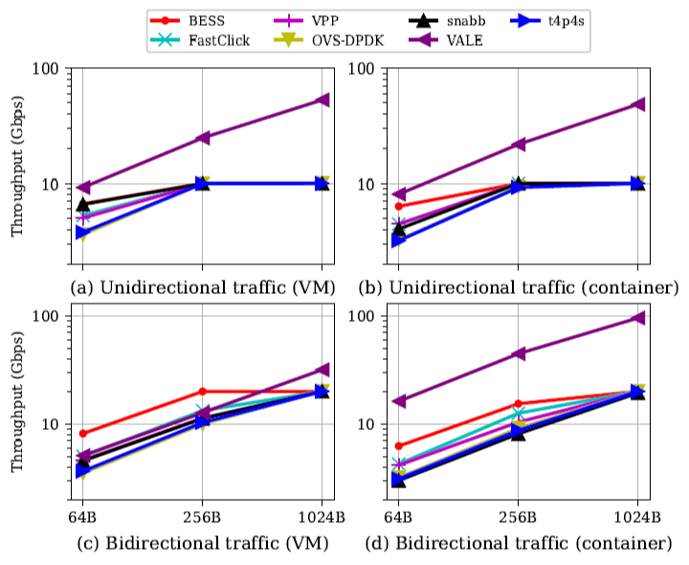
Throughput test for v2v scenario

Slide 23
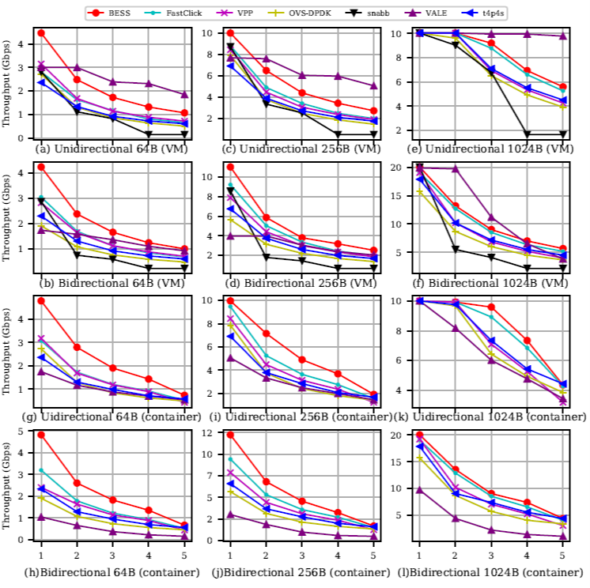
Throughput test for loopback scenario

Slide 24
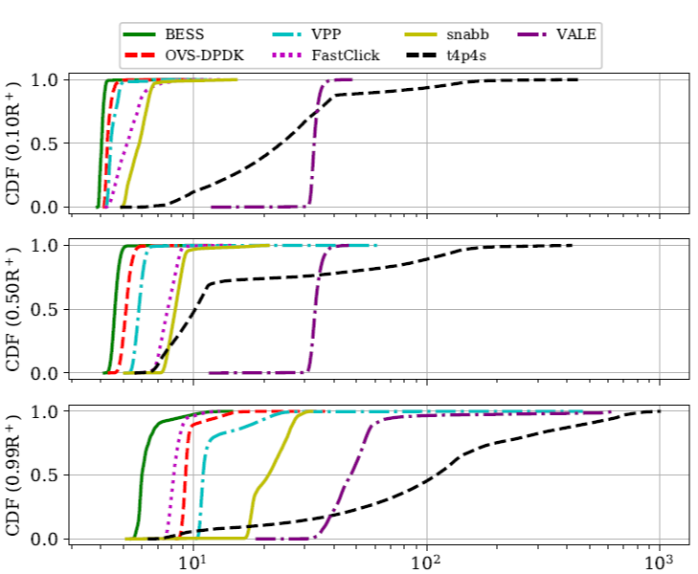
Latency test for p2p scenario

Slide 25
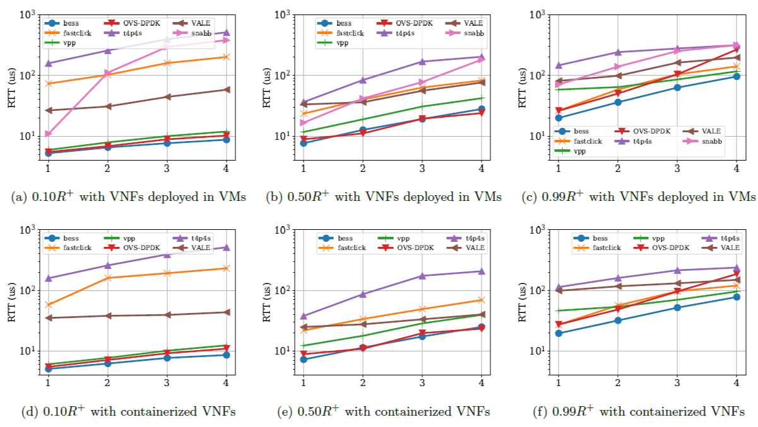
Latency test for loopback scenario

Slide 26
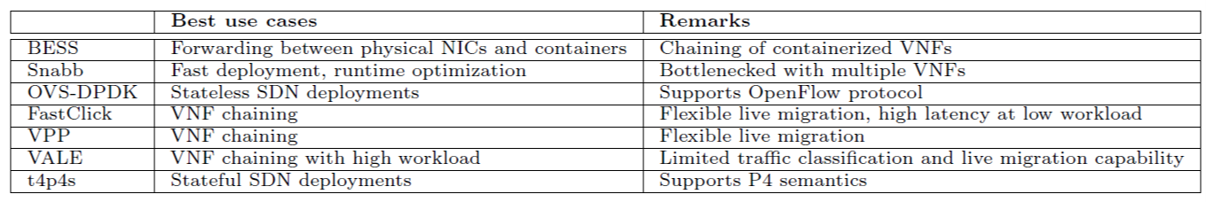
Use case summary
Notes:
There is no absolute winner that can outperform the others in all the test scenarios. Similar performance with VM and container
Based on the results and our experience using them:
BESS achieves the best performance with containers.
Snabb is best for fast-prototyping but performs poorly with SFCs.
FastClick, VPP, and VALE are suitable for SFCs.
OVS-DPDK and t4p4s are less performant in NFV settings, but they have other valuable functionalities.

Slide 27


Conclusion
Software switches are widely used by NFV frameworks
It calls for a benchmarking methodology to assess their performance
Our approach provides a comprehensive evaluation of software switches in a typical NFV environment
Quantitative measurement with qualitative evaluation
Code reproducible and available on GitHub

Slide 28

Thanks!!!

